Slide 1
Assessment of Marginal Workers in Tamil Nadu- A Socioeconomic Analysis
Team number=01
Vemula Lakshmi Naga Balaji (team member)

Slide 2
Project Documentation
Project objective:
The main objective of the project is to analyze the given csv file big data of marginal workers of Tamil Nadu and to provide in a proper virtual understanding by data visualization techniques like scatter plot ,bar chart, histogram, pie chart etc.. can be used.
Analyze approach:
Clean and prepare the data.
This may involve removing any duplicate rows, handling missing values, and converting the data into the appropriate format for your analysis.
Calculate the share of marginal workers in the total workforce.
This can be done by dividing the number of marginal workers by the total number of workers in your dataset.
Virtualization types:
Create a pie chart.
A pie chart is a type of chart that shows the proportional relationship between different categories. To create a pie chart for your marginal worker analysis, you will need to divide the pie into slices, each representing a different category of workers. For example, you could divide the pie into slices for marginal workers, non-marginal workers, and unemployed workers.
Label the pie slices and add a title.
The pie slices should be labelled with the category of workers that they represent. The title of the pie chart should be descriptive and informative
Other virtualization types:
Some of the other virtualization types are pie chart, bar chart, histogram, pie plot, scatter plot, etc.
3. Code implementation:
We used Python code programming language for the big data analysis purpose to virtualize the given csv file

Slide 3
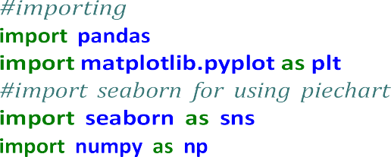

This code will create a pie chart that shows the distribution of virtualization types among marginal workers. The chart shows that the majority of marginal workers use desktop virtualization. This suggests that desktop virtualization is the most popular type of virtualization among marginal workers.
You can also use a pie chart to analyse the distribution of virtualization types across different industries or occupations. Simply change the categories in the pie chart to the industries or occupations that you want to analyse.
[1]:
1 Importing csv file data sets
[2]:
2 checking the data fully filled that is fully true
[3]:
[3]:
0
1
2
3
4
.. 589
590
591
592
593
Table Code State Code
District Code
False False False False False
…
False False
False False False
Area Name Total/ Rural/ Urban \
False False False False False
… False False
False False False
False False False False False
… False False
False False False
False False False False False
False False False False False
False False False False False
False False False False False
…
…
Age group Worked for 3 months or more but less than 6 months - Persons \

Slide 4
0
1
2
3
False False False False
False False False False

Slide 5
4
.. 589
590
591
592
593
False
… False False False False
False
False
… False False False False
False
0
1
2
3
4
.. 589
590
591
592
593
Worked for 3 months or more but less than 6 months - Males \
False False False False False
… False False False False
False
Worked for 3 months or more but less than 6 months - Females \
False False False False False
… False False False False
False
Worked for less than 3 months - Persons … \
0
1
2
3
4
.. 589
590
591
592
593
0
1
2
3
4
.. 589
590
591
592
593
False …
False …
False …
False …
False …
… … False …
False …
False …
False …
False …

Slide 6
0 | Industrial Category - N to O - Females | \
1 | False
2 | False
3 | False
4 .. | False
589 | False
590 | False
591 | False
592 | False
593 | False
0 | Industrial Category - P to Q - Persons | \
1 | False
2 | False
3 | False
4 .. | False
589 | False
590 | False
591 | False
592 | False
593 | False
0 | Industrial Category - P to Q - Males \
1 | False
2 | False
3 | False
4 .. | False
589 | False
590 | False
591 | False
592 | False
593 | False
0 | Industrial Category - P to Q - Females | \
1 | False
2 | False
3 | False
4 .. | False
589 | False
False
…
False
…
False
…
False
…

Slide 7
590 | False
591 | False
592 | False
593 | False
0
1
2
3
4
.. 589
590
591
592
593
Industrial Category - R to U - HHI - Persons \
False False False False False
…
False False False False
False
0
1
2
3
4
.. 589
590
591
592
593
Industrial Category - R to U - HHI - Males \
False False False False False
…
False False False False
False
0
1
2
3
4
.. 589
590
591
592
593
Industrial Category - R to U - HHI - Females \
False False False False False
… False False False False
False
0
1
Industrial Category - R to U - Non HHI - Persons \
False
False

Slide 8


2
3
4
.. 589
590
591
592
593
False False False
… False False False False
False
Industrial Category - R to U - Non HHI - Males \
False False False False False
… False False False False
False
Industrial Category - R to U - Non HHI - Females
False False False False False
… False False False False
False
0
1
2
3
4
.. 589
590
591
592
593
0
1
2
3
4
.. 589
590
591
592
593
[594 rows x 69 columns]
3 Fetching and describe the data
[4]:
[5]:

Slide 9
[6]:
[6]:
count mean std min 25%
50%
75%
max
Worked for 3 months or more but less than 6 months - Persons \
5.940000e+02
1.617277e+04
7.607172e+04
0.000000e+00
2.872500e+02
2.225500e+03
9.628500e+03
1.200828e+06
Worked for 3 months or more but less than 6 months - Males \
594.000000
7932.700337
36864.822704
0.000000
147.250000
1147.000000
4770.500000
589003.000000
count mean std min 25%
50%
75%
max
count mean std min 25%
50%
75%
max
Worked for 3 months or more but less than 6 months - Females \
594.000000
8240.067340
39259.545337
0.000000
144.000000
1076.000000
4887.500000
611825.000000
ess than 3 months - Persons \
_{count} Worked for l | 594.000000
mean | 2981.629630
std | 13909.621137
min | 0.000000
25% | 27.000000
50% | 430.000000
75% | 1775.250000
max | 221386.000000
count mean std
min
Worked for less than 3 months - Males \
594.000000
1338.289562
6127.047670
0.000000

Slide 10
25% | 14.250000
50% | 198.500000
75% | 774.250000
max | 99368.000000
count mean std min 25%
50%
75%
max
Worked for less than 3 months - Females \
594.000000
1643.340067
7808.832522
0.000000
13.000000
213.000000
946.500000
122018.000000
ry - A - Cultivators - Persons \
_{count} Industrial Catego | 594.000000
mean | 865.117845
std | 4274.458077
min | 0.000000
25% | 9.000000
50% | 69.500000
75% | 466.000000
max | 64235.000000
count mean std min 25%
50%
75%
max
Industrial Category - A - Cultivators - Males \
594.000000
466.424242
2298.072295
0.000000
5.000000
35.500000
244.250000
34632.000000
Industrial Category - A - Cultivators - Females \
594.000000
398.693603
1978.682322
0.000000
4.000000
32.000000
204.750000
29603.000000
Industrial Category - A - Agricultural labourers - Persons … \
594.000000 …
count mean std min 25%
50%
75%
max
count

Slide 11
mean | 12225.616162 | …
std | 60458.382586 | …
min | 0.000000 | …
25% | 79.250000 | …
50% | 1094.000000 | …
75% | 6279.750000 | …
max | 907752.000000 | …
 | Industrial | Category | - | N | to | O - Females | \
count |  |  |  |  |  | 594.000000
mean |  |  |  |  |  | 48.013468
std |  |  |  |  |  | 222.553500
min |  |  |  |  |  | 0.000000
25% |  |  |  |  |  | 0.000000
50% |  |  |  |  |  | 2.000000
75% |  |  |  |  |  | 18.000000
max |  |  |  |  |  | 3565.000000
count mean std min 25%
50%
75%
max
Industrial Category - P to Q - Persons \
594.000000
149.225589
696.553730
0.000000
0.000000
14.500000
99.750000
11080.000000
Industrial Category - P to Q - Males \
594.000000
54.127946
253.067862
0.000000
0.000000
6.000000
35.750000
4019.000000
Industrial Category - P to Q - Females \
594.000000
95.097643
444.011425
0.000000
0.000000
6.500000
64.000000
7061.000000
count mean std min 25%
50%
75%
max
count mean std min 25%
50%
75%
max

Slide 12
count mean std min | Industrial Category - R to U - HHI - Persons \ 226.707071 0.000000
25% | 0.000000
50% | 27.000000
75% | 126.750000
max | 16833.000000
count mean std min | Industrial Category - R to U - HHI - Males \ 57.454545 0.000000
25% | 0.000000
50% | 7.500000
75% | 32.000000
max | 4266.000000
count mean std min | Industrial Category - R to U - HHI - Females \ 169.252525 0.000000
25% | 0.000000
50% | 20.000000
75% | 97.500000
max | 12567.000000
count mean std min | Industrial Category - R to U - Non HHI - Persons 1644.282828 0.000000 | \
25% | 64.500000
50% | 263.500000
75% | 994.000000
max | 122088.000000
count mean std min 25% | Industrial Category - R to U - Non HHI - Males \ 751.528620 0.000000
594.000000
1039.953069
594.000000
265.230865
594.000000
776.206806
594.000000
7325.241597
594.000000
3352.811737
34.000000

Slide 13
count mean std min 25%
50%
75%
max
Industrial Category - R to U - Non HHI - Females
594.000000
892.754209
3988.125301
0.000000
30.500000
135.000000
500.000000
66287.000000
[8 rows x 63 columns]
[7]: 50% |  | 123.000000
75% |  | 447.750000
max |  | 55801.000000
[7]: | (0 | 611825
 | 1 | 13666
 | 2 | 254780
 | 3 | 290624
 | 4 | 52270
 | 589 | … | 143
 | 590 | 1631
 | 591 | 1903
 | 592 |  | 297
 | 593 |  | 1
 | Name: Worked for 3 months or more but less than 6 months - Females, Length: 594, dtype: int64,
 | 0 | 589003
 | 1 | 14125
 | 2 | 259560
 | 3 | 251957
 | 4 | 62833
 | 589 | … | 129
 | 590 | 1654
 | 591 | 1769
 | 592 |  | 399
 | 593 |  | 1
 | Name: | Worked for 3 months or more but less than 6 months - Males, Length: 594,
 | dtype: | int64)

Slide 14
[8]:

Slide 15
[8]: | (0 | 3565
 | 1 |  | 11
 | 2 | 1754
 | 3 | 1619
 | 4 | 175 …
 | 589 |  | 0
 | 590 |  | 20
 | 591 |  | 33
 | 592 |  | 0
 | 593 |  | 0
 | Name: | Industrial |  | Category - N to O - Females, Length: 594, dtype: int64,
 | 0 | 11080
 | 1 |  | 122
 | 2 | 7536
 | 3 | 3205
 | 4 | … | 211
 | 589 |  | 0
 | 590 |  | 44
 | 591 |  | 35
 | 592 |  | 3
 | 593 |  | 0
 | Name: | Industrial |  | Category - P to Q - Persons, Length: 594, dtype: int64)
[9]:
# assigning the csv data to variable of piechart
pie_chart_data = df['Worked for 3 months or more but less than 6 months - ␣
↪Persons']
#asigning values to the pie chart
plt.pie(pie_chart_data, labels=df['Worked for 3 months or more but less than 6␣
↪months - Persons'], autopct='%1.1f%%',radius=7.5)
plt.title('Pie Chart Title') #printing the pie chart plt.show()

Slide 16
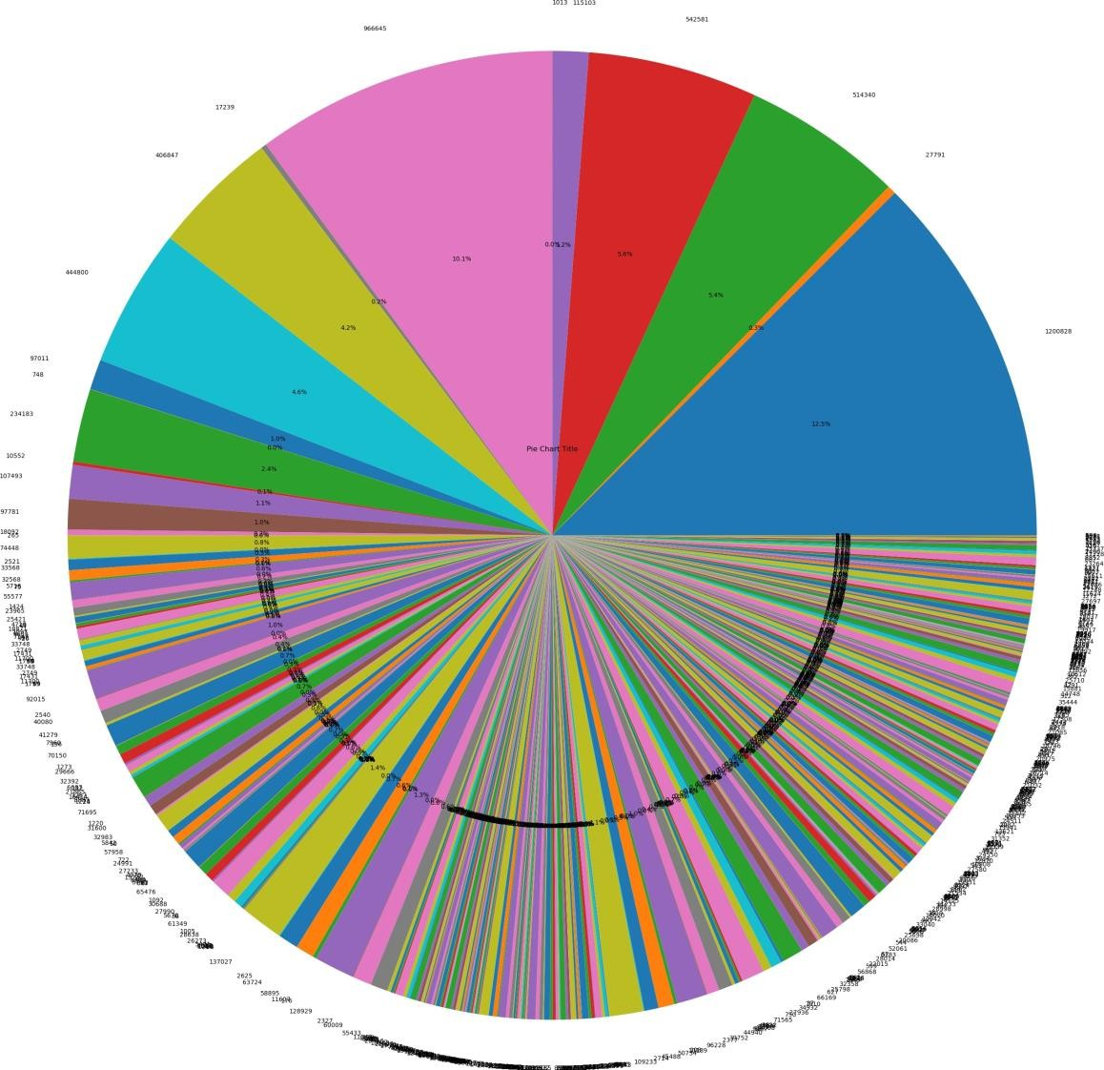
4 printing the pie chart using the given csv file data sets
[10]:
price = df["Age group"]
5 visualizing the data sets column in the form of of histogram
[11]:
[11]: (array([99., 0., 99., 0., 99., 0., 99., 0., 99., 99.]),
array([0. , 0.5, 1. , 1.5, 2. , 2.5, 3. , 3.5, 4. , 4.5, 5. ]),
<BarContainer object of 10 artists>)

Slide 17
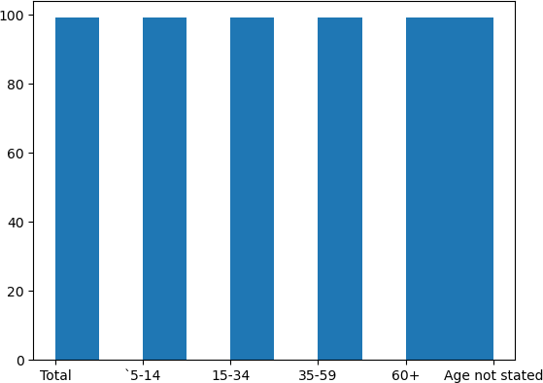
[16]:
column_1 = df["Age group"]
column_2 = df["Industrial Category - A - Cultivators - Persons"]
# Create the histogram
fig, axs = plt.subplots(1, 2)
axs[0].hist(column_1) axs[1].hist(column_2)
# Add a title and axis labels for each subplot axs[0].set_title("Histogram of {} Column".format(column_1.name)) axs[1].set_title("Histogram of {} Column".format(column_2.name))
axs[0].set_xlabel(column_1.name) axs[1].set_xlabel(column_2.name)
axs[0].set_ylabel("Count") axs[1].set_ylabel("Count")
# Adjust the subplot layout
plt.tight_layout()

Slide 18
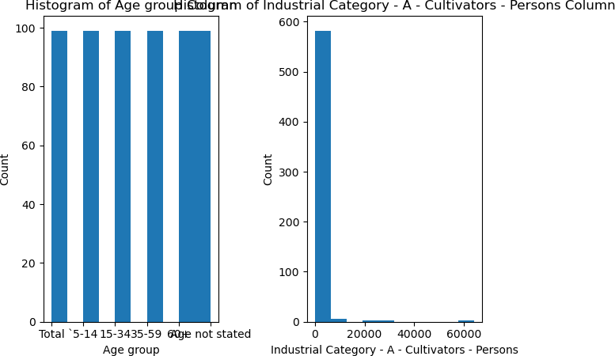
# Show the plot
6 visualizing three different columns by using scatter plot
x_column = df["Age group"]
y_column = df["Industrial Category - A - Plantation, Livestock, Forestry,␣
↪Fishing, Hunting and allied activities - Persons"]
[26]:
z_column = df["Industrial Category - C - HHI - Persons"]
# Create the scatter plot
plt.scatter(x_column, y_column, z_column)
# Add a title and axis labels
plt.title("Scatter Plot of {} vs. {}".format(x_column.name, y_column.name,␣
↪z_column.name))
plt.xlabel(x_column.name) plt.ylabel(y_column.name) plt.ylabel(z_column.name)
# Show the plot
plt.show()

Slide 19
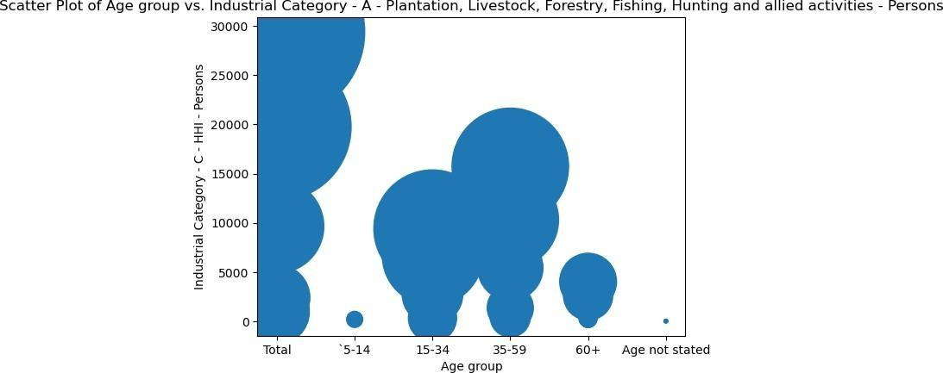
7 output for the scatter plot for the gib=ven three columns

